Slide 1
Energy Management System
Power Line Communication
Ryan McLaughlin

Slide 2
Overview
Introduction
Risk Specification
Risk Investigation
Risk Mitigation
Testing Strategy
Uncertainties

Slide 3
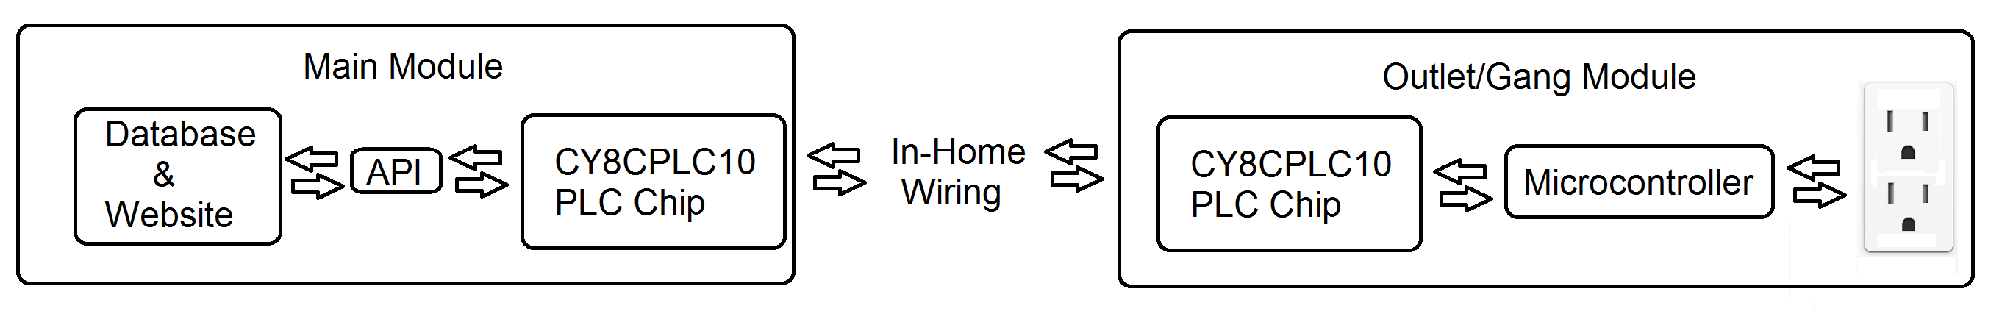
Power Line Communication
The Power Management System consists of a centralized database that receives usage data from outlet modules, as well as sending commands to them. Without a reliable form of communication between the outlets and the main module, the system cannot perform it’s designated roll. Thus it was vital to investigate the possibilities when incorporating PLC in the design.

Slide 4
Risk Specification
Marketing Requirements
1. The system shall allow for control of individual outlets.
2. The system shall be safe.
3. The system shall have low cost in comparison to competitive products.
4. The system shall be of reasonable size in comparison to existing systems.
5. The system shall communicate usage data and commands between outlets and the main module.

Slide 5
Risk Specification
Engineering Specifications
Marketing requirements | Engineering Requirements | Justification
3 | Production cost should not exceed $200 for the main unit and $50 for the outlet modules. | This is based upon analysis of a competitive market and current design requirements.
2 | Control circuits shall be isolated from power line by 1250V RMS minimum. | Electrical isolation is required by safety agencies for equipment connected to the AC power line.
2 | The system shall use only UL recognized components. | Safety agency approvals will be required to sell product commercially.
4 | The system shall be able to fit into current standard electrical outlets. | To be fully integrated and competitive, the system must be able to replace current outlets.
1,5 | Wall units shall be identifiable. | This allows the system to know what information is coming from what wall unit and to provide individual control.
1,5 | All modules should be able to transmit at a BPS rate sufficient to relay commands and usage data at the chosen sampling frequency. | In order to have reliable communication, the modules must have an adequate minimum communication rate.

Slide 6
Risk Investigation
Power Line Communication:
“Mature” Technology -> Find a chip that provides target BPS
The “right” chip will incorporate collision handling
Frequency will be predetermined by chips, and will avoid low harmonics of 60 hz
Goal is to find a chip that meets our data rate requirement, which will hopefully handle collisions.

Slide 7
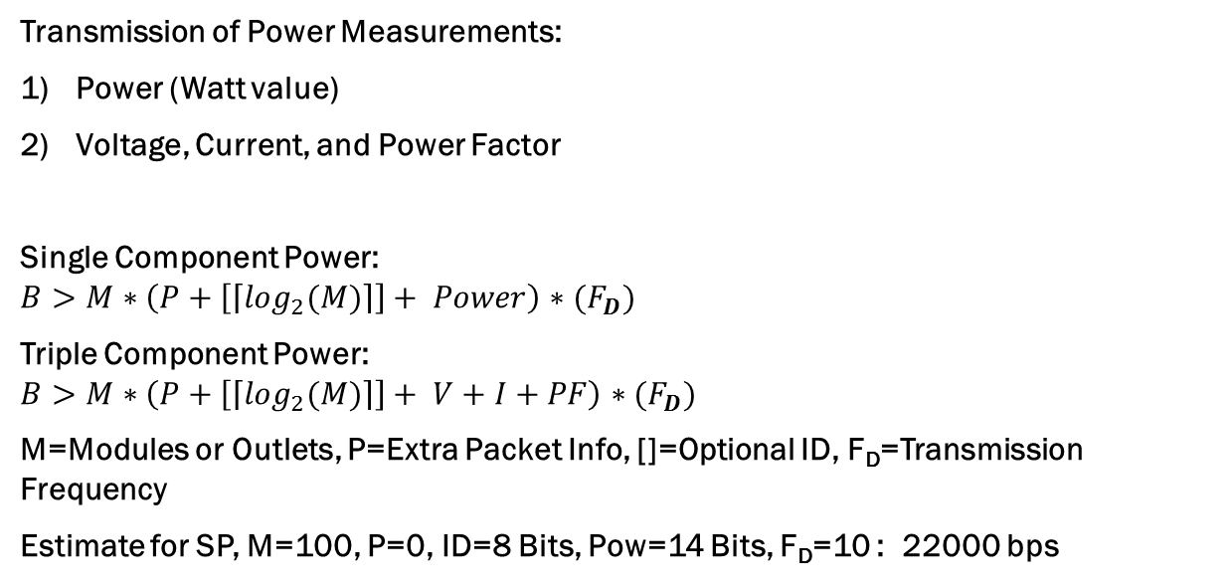
Risk Investigation
Transmission of Power Measurements:
Power (Watt value)
Voltage, Current, and Power Factor
Single Component Power:
$$B>M∗\left(P+\left[\left\lceil \log_{2}(M)\right\rceil \right]+ Power\right)∗(F_{D})$$
Triple Component Power:
$$B>M∗\left(P+\left[\left\lceil \log_{2}(M)\right\rceil \right]+ V+I+PF\right)∗(F_{D})$$
M=Modules or Outlets, P=Extra Packet Info, []=Optional ID, F_{D}=Transmission Frequency
Estimate for SP, M=100, P=0, ID=8 Bits, Pow=14 Bits, F_{D}=10 : 22000 bps

Slide 8
Risk Investigation
Complexity Differences
Part | Packet Bits | Provided Data Rate | Collision Provisions | Interface
CY8CPLC10 | 56 | 2400 | Yes | I2C
CY8CPLC20 | 56 | 2400 | Yes | I2C, UART
ST7540 | 0 | 4800 | No | UART/SPI
ST7570 | 112-336 | 2400 | Yes | UART
ST7590 |  | 128000 | Yes | UART/SPI
MAX2992 |  | 300000 | Yes | UART/SPI
ATSAM4CP16B |  | 128000 | Yes | UART/SPI
TDA5051A | 0 | 1200 | no | Digital

Slide 9
Risk Mitigation
Avoiding complex chips requires reduction of data sent
Transmission Frequency Options:
All transmit real time ( > once per second)
All transmit slowly (< once per second)
Hybrid (Real time & Sub real time)
Combine Power Measurement per gang, not per outlet (1/2 data)
Separate On/Off

Slide 10
Risk Mitigation
Further, can reduce bits sent for each power component.
SP: 14 bits of precision too high – perhaps 11
TP: V: 5-6 bit measure from 100 V, I:10-11 bits, PF:5-6 bits
New Equations:
SP: 𝐵>(𝑀𝐹𝐷+𝑀𝑅𝐹𝑅−𝑀𝑅𝐹𝐷)∗(𝑃+[⌈𝑙𝑜𝑔2(𝑀)⌉]+ 𝑃𝑜𝑤𝑒𝑟)
TP: 𝐵>(𝑀𝐹𝐷+𝑀𝑅𝐹𝑅−𝑀𝑅𝐹𝐷)∗(𝑃+[⌈𝑙𝑜𝑔2(𝑀)⌉]+ 𝑉+𝐼+𝑃𝐹)
Assuming CY8CP10/20 (p=56), new bit values, and M_{R}(modules)=5,
SP: 536 bps (out of 2400)
TP: 632 bps (out of 2400)

Slide 11
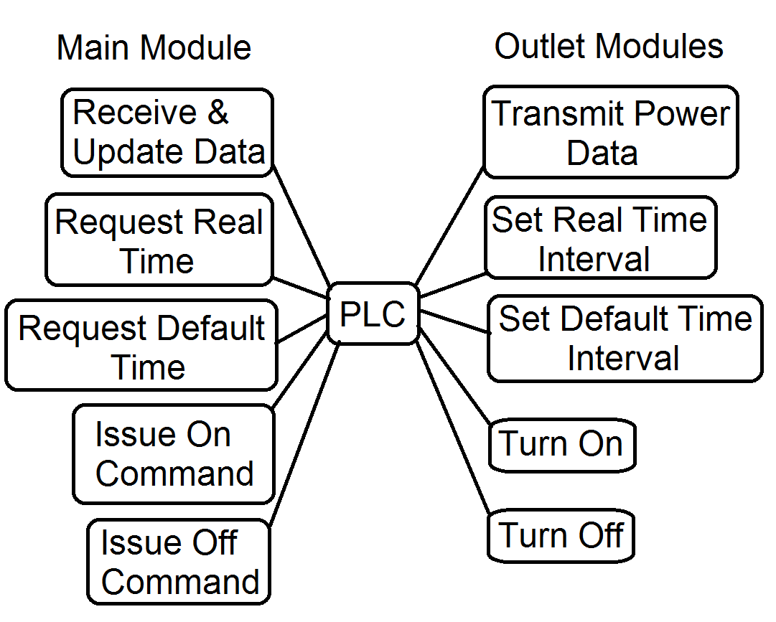
Risk Mitigation

Slide 12
Risk Mitigation
While the CY8CPLC10/20 Chip has not been chosen yet, it is a balanced chip:
28 Pins (between 16&48) making it middle ground for size/routing concerns
Full Collision handling means no compromise
Adequate speed for maintained real time statistics given modifications
Options for circuit coupling are transformer vs capacitive coupling, which will be decided based on microcontroller’s coupling. (loss of isolation advantage if using a transformer when the microcontroller isn’t)

Slide 13
Testing
Vital to choose & test chip(s) as soon as possible.
At least four phases of testing recommended
Microcontroller & PLC
(Microcontroller & PLC)x2
Full unit test, test sending commands to relay/switch, etc
Completion Tests

Slide 14
Uncertainties
Coupling Circuitry (Determined by microcontroller)
PLC chip choice
Smaller chip is more easily integrated, but doesn’t leave huge speed margin
Examination of number of pins vs routing complexity
Chip prices
Fit within single gang box, or require 2?

Slide 15
References
A special thanks to Dr. Kwasinski for his support & advice.
Datasheets:
http://www.cypress.com/?docID=45757
http://www.cypress.com/?docID=50840
http://www.st.com/web/en/resource/technical/document/datasheet/CD00096923.pdf
http://www.st.com/web/en/resource/technical/document/datasheet/CD00274120.pdf
http://www.st.com/st-web-ui/static/active/en/resource/technical/document/datasheet/CD00294970.pdf
http://www.atmel.com/Images/doc43051H.pdf
http://www.nxp.com/documents/data_sheet/TDA5051A.pdf
Application Notes:
http://www.cypress.com/?docID=46702
http://www.st.com/web/en/resource/technical/document/application_note/CD00143379.pdf
http://www.st.com/web/en/resource/technical/document/application_note/CD00271738.pdf
http://www.st.com/st-web-ui/static/active/jp/resource/technical/document/application_note/DM00037363.pdf

